Slide 1
Lecture 19b:
5.2.2 Eastern Europe: Fall of Really Existing Socialism
Brad DeLong
Department of Economics & Blum Center, U.C. Berkeley; & WCEG
last revised: Th 2020-04-03
for presentation: Tu 2020-04-07
Original course by Melissa Dell (Harvard Econ 1342), revised by Brad DeLong
<https://github.com/braddelong/public-files/blob/master/econ-135-lecture-19b.pptx>
<https://www.icloud.com/keynote/0PmM5m3ew16yzegH3YQJrblLQ>

Slide 2

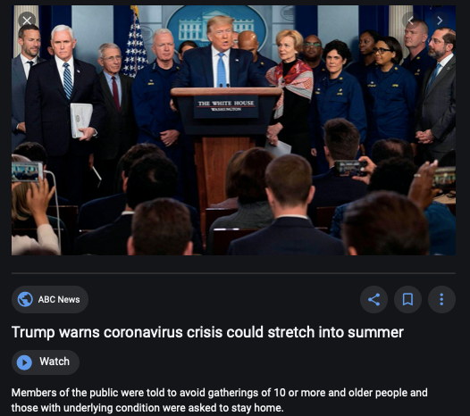
Coronavirus!

Slide 3
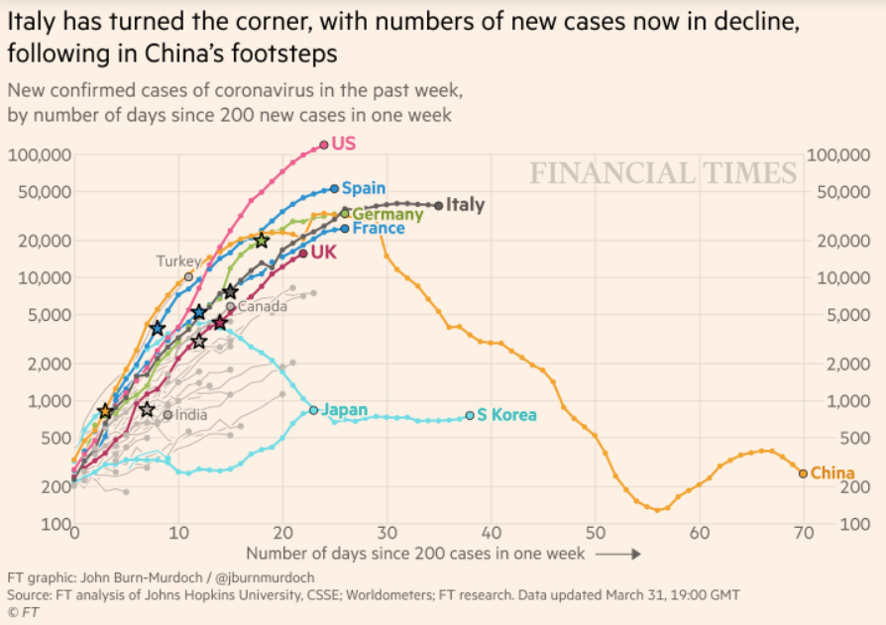
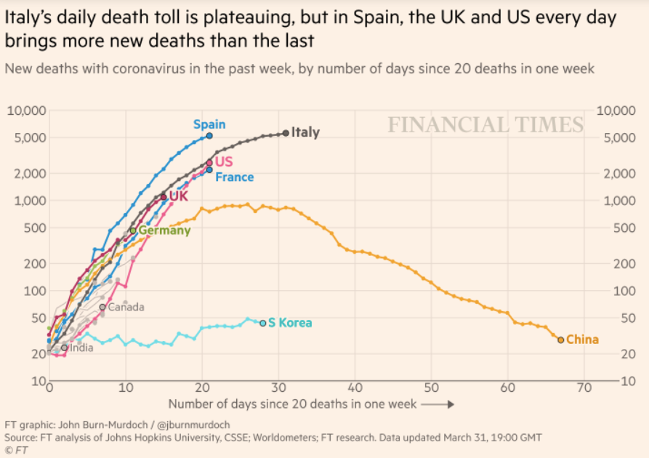
Coronavirus
Where we think we are as of Wed Apr 1:
We really do not know
No random samples…
Best thing I have read comes from Jim Stock <https://drive.google.com/file/d/12MV466ZZy5xHir4xdPhoTrL1oO8CbZU-/view>:
The basic SIR epidemiological model of contagion
The effect of social distancing and business shutdowns on epidemic dynamics enters the model through a single parameter: the case transmission rate β
Re-express the model in terms of β and the asymptomatic (or not very symptomatic) hence non-tested rate—the fraction of the infected who are not tested
The COVID-19 non-testing rate is unidentified in our model
Estimates in the epidemiological literature range from 0.18 to 0.86.
The asymptomatic rate could be estimated accurately and quickly by testing a random sample
The optimal policy response and its economic consequences hinge critically on the asymptomatic rate

Slide 4
Financial Times Graphs Blown Up…

Slide 7
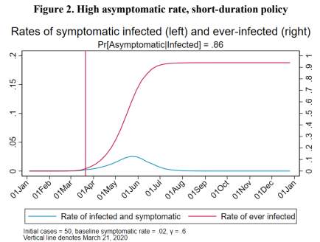
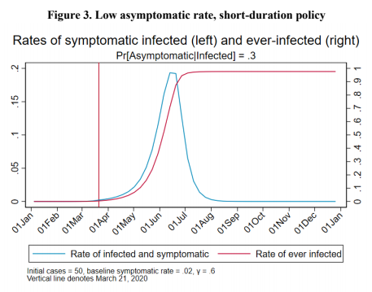
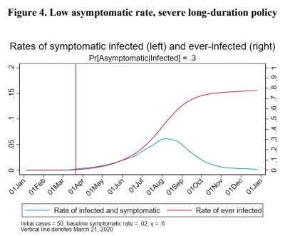
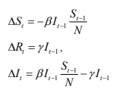
James Stock (2020)
Standard SIR model:<https://drive.google.com/file/d/12MV466ZZy5xHir4xdPhoTrL1oO8CbZU-/view>:
Susceptible, Infected, Recovered (& immune), transmission rate β, recovery rate γ, reproduction number R0, asymptomatic hence non-tested rate π0
Calibration: half-life of infection one week: γ = 0.5, s0 = 0.02, 50 cases on Jan 24
For March 21, 2020, the positive test rate in the United States is approximately 10%…
<https://drive.google.com/file/d/12MV466ZZy5xHir4xdPhoTrL1oO8CbZU-/view>

Slide 12
Bringing the Economy Back Up from Anæsthesia
Major issues:
Certificates of immunity:
Which requires test, test, test:
And not just disease virus tests
Presence-of-antibodies tests
How quickly can we match the immune with public-contact jobs?
What jobs can be done with minimal infection risk?
What minimal-infection substitutes can we find for previous jobs?
How quickly can restrictions be relaxed without the virus coming roaring back?
How do we avoid having the market give a “shutdown” signal to enterprises we in fact want restarted?
Which is pretty much all of them
How much of the potential caseload do we want to push out beyond the vaccine-arrival date?
ALL THESE QUESTIONS ARE ANSWERABLE IF WE LEARN THE ASYMPTOMATIC HENCE NON-TESTED RATE!!

Slide 13
Keeping the Economy from Crashing During the Lockdown
Nick Rowe: We have a 50% output cut in 100% of the sectors:
A temporary 100% output cut in 50% of the sectors (what the Coronavirus does) is very different from a 50% output cut in 100% of the sectors
Nick’s thought experiment:
In three months we are going to invent unobtanium:
Substantial intertemporal substitutibility
Plus lower cross-good contemporaneous substitutitbility
Hence high desired savings rate now
Flex-price market thus produces a nominal rate at the zero lower bound and a high inflation rate over the next three to six months
Plus liquidity-constrained workers in affected sectors see their demand go to zero immediately
Can we get there? Should we get there? What should we do instead?
We need a good RBC economist: are there any?…
<https://worthwhile.typepad.com/worthwhile_canadian_initi/2020/03/relative-supply-shocks-unobtainium-walras-law-and-the-coronavirus.html>

Slide 14
Keeping the Economy from Crashing During the Lockdown II
Nick Rowe <https://worthwhile.typepad.com/worthwhile_canadian_initi/2020/03/relative-supply-shocks-unobtainium-walras-law-and-the-coronavirus.html>:
Plus: to extend the thought experiment:
We just lost the ability to make “unobtainium”
So we should be substituting leisure for work, and moving workers into relatively unproductive labor, making the commodities we can still produce right now
How should relative prices move as a result? How should we make them move?
Plus: distributional issues
Plus: bankruptcy and credit chain issues

Slide 15

MOAR Coronavirus!
Death for Geezers!
Mortality for the Youngs very low…
It’s the flu for them—for you…
And an extra doubling—or is it 5%?—mortality for the asthmatic
And an extra doubling—or is it 5%?—mortality for the overweight

Slide 16
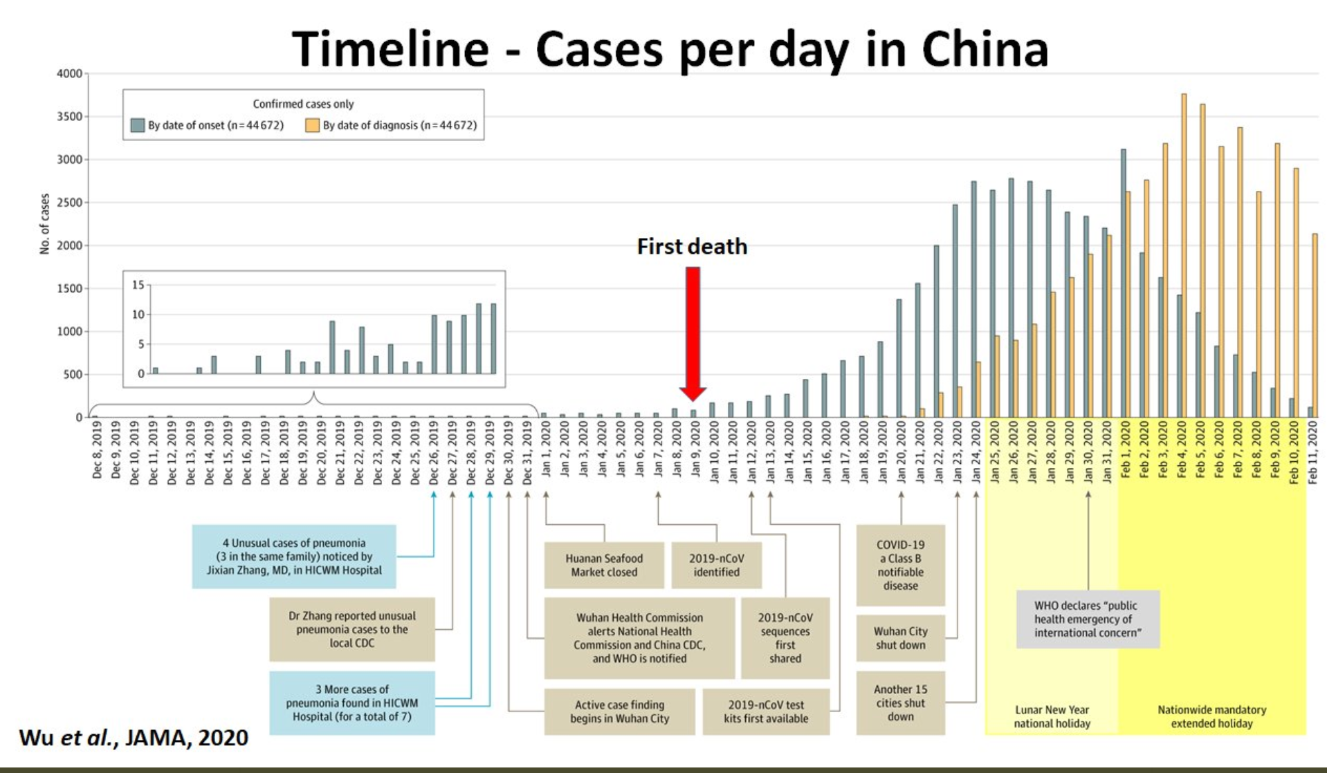
What We Think Happened in Wuhan
China beat it quickly & relatively easily!
We think
Shut down Wuhan when 200 cases per day
That seems to have been a good decision

Slide 17

The Goal
When Is It Appropriate to Move on This?
Immediate social distancing…
Self-isolate if you have a cough and a fever…
Hope that warmer temperatures will do to this what they did to SARS…
Otherwise, when do you want to start spreading out transmission. It seems that early is as good as later, so do it early…
I have no good intuition on why you want to move early
Plus your moving early will be wasted if you get reinfected
Plus the sparks you throw off making others’ lives more difficult

Slide 18
References
Financial Times (2020): Coronavirus Tracked: The Latest Figures as the Pandemic Spreads <https://www.ft.com/coronavirus-latest>
Nick Rowe (2020): Relative Supply Shocks, Unobtainium, Walras' Law, and the Coronavirus <https://worthwhile.typepad.com/worthwhile_canadian_initi/2020/03/relative-supply-shocks-unobtainium-walras-law-and-the-coronavirus.html>
Jim Stock (2020): Coronavirus Data Gaps and the Policy Response <https://drive.google.com/file/d/12MV466ZZy5xHir4xdPhoTrL1oO8CbZU-/view>

Slide 19
MOAR Coronavirus!
What I am watching:
Max Roser & Hannah Ritchie: Coronavirus Disease (COVID-19) <https://ourworldindata.org/coronavirus>…
Worldometer: Coronavirus Update (Live) <https://www.worldometers.info/coronavirus/>: ‘125,599 Cases and 4,605 Deaths from COVID-19 Virus Outbreak…
FT Coronavirus Tracker <https://www.ft.com/content/a26fbf7e-48f8-11ea-aeb3-955839e06441>
Josh Marshall’s COVID Twitter List <https://twitter.com/i/lists/1233998285779632128>
NEJM Group: Updates on the Covid-19 Pandemic <http://m.n.nejm.org/nl/jsp/m.jsp?c=%40kxNtXckRDOq8oG0jJvAXsIzN4mPECIPhltxoTSdTU9k%3D&cid=DM89089_NEJM_COVID-19_Newsletter&bid=173498255>: 'From the New England Journal of Medicine, NEJM Journal Watch, NEJM Catalyst, and other trusted sources...

Slide 20
Catch Our Breath…
Ask a couple of questions?
Make a couple of comments?
Any more readings to recommend?
<https://www.icloud.com/keynote/0YKEi7HeOrVGvKYtt9FEqH7nA>

Slide 21
Roadmap for the Next Two Weeks…
5. Touring the Continents
19. Tu Apr 7: 5.2. Behind the Iron Curtain: The Rise & Fall of Really Existing Socialism
Read Before: Richard Ericson (1991): The Classical Soviet-Type Economy: Nature of the System and Implications for Reform <https://delong.typepad.com/files/ericson-soviet.pdf>
Slides: <https://github.com/braddelong/public-files/blob/master/econ-135-lecture-19.pptx> <https://github.com/braddelong/public-files/blob/master/econ-135-lecture-19b.pptx>
20. Th Apr 9: 5.3. East Asian Miracles
Read Before: Peter Evans (1995): Embedded Autonomy: States and Industrial Transformation, chapter 1 <https://delong.typepad.com/files/evans-embedded-i.pdf>
Read Before: Yingyi Qian (2001): How Reform Worked in China <https://delong.typepad.com/files/qian-reform.pdf>
Slides: <https://github.com/braddelong/public-files/blob/master/econ-135-lecture-20.pptx>
21. Tu Apr 14: 5.4. Asia and Africa
Read Before: Nathan Nunn (2008): The Long Term Effects of Africa's Slave Trades <https://dash.harvard.edu/bitstream/handle/1/3710252/Nunn_Long-TermEffects.pdf>
Read Before: Sevkut Pamuk (2014): Institutional Change and Economic Development in the Middle East, 700-1800 <https://delong.typepad.com/files/pamuk.pdf>
Slides: <https://github.com/braddelong/public-files/blob/master/econ-135-lecture-21.pptx>
6. Policy Issues
22. Th Apr 16: 6.1. "Deep Roots" vs. Path Dependence
Read Before: Nathan Nunn (2012): Culture and the Historical Process <https://delong.typepad.com/files/nunn-culture.pdf>
Read Before: Melissa Dell (2015): Path Dependence in Development: Evidence from the Mexican Revolution <https://scholar.harvard.edu/files/dell/files/revolutiondraft.pdf>
Slides: <https://github.com/braddelong/public-files/blob/master/econ-135-lecture-22.pptx>
23. Tu Apr 21: 6.2. Growth and Fluctuations; Trade and Development, Foreign Aid
Read Before: Barry Eichengreen (2015): Hall of Mirrors: The Great Depression, The Great Recession, and the Uses-and Misuses-of History, selections <https://delong.typepad.com/files/eichengreen-mirrors.pdf>
Read Before: David Atkin (2014): Endogenous Skill Acquisition and Export Manufacturing in Mexico <https://delong.typepad.com/files/atkin-skill.pdf>
Slides: <https://github.com/braddelong/public-files/blob/master/econ-135-lecture-23.pptx>

Slide 22
Roadmap Following: 6. Policy Issues…
Th Apr 23: 6.3. Populism, Plutocracy, Kleptocracy, & Neo-Fascism
Read Before: Ernest Gellner (1973): Nations & Nationalism, selections <https://delong.typepad.com/files/gellner-nations.pdf>
Read Before: Barry Eichengreen (2018): The Populist Temptation Economic Grievance & Political Reaction in the Modern Era, selections <https://delong.typepad.com/files/eichengeeen-populist.pdf >
Tu Apr 28: 6.4. Global Warming
Read Before: Melissa Dell et al. (2012): Temperature Shocks & Economic Growth: Evidence from the Last Half Century <https://scholar.harvard.edu/files/dell/files/aej_temperature.pdf>
Read Before: Melissa Dell et al. (2014). What Do We Learn from the Weather? The New Climate-Economy Literature, selections <https://economics.mit.edu/files/9138>
Th Apr 30: 6.5. The Pace and Meaning of Economic Growth
Read Before: William Nordhaus: Do Real-Output and Real-Wage Measures Capture Reality? <https://www.nber.org/chapters/c6064.pdf>
Read Before: John Maynard Keynes: Economic Possibilities for Our Grandchildren<<https://delong.typepad.com/files/keynes-persuasion.pdf>
Read Before: Edward Bellamy (1887): Looking Backward 2000-1887, selections <https://delong.typepad.com/files/bellamy-backward.pdf>
7. Conclusion
Tu May 5: 7. Conclusion: The Future?
Read After: Robert Allen (2011): Global Economic History: A Very Short Introduction, selections <https://delong.typepad.com/files/allen-geh.pdf >
W May 13 11:30-14:30: FINAL PAPER/PROJECT DUE

Slide 23
Discussion
Touring the Continents: Behind the Iron Curtain
What strikes you as important here?

Slide 24

Really Existing Socialism’s End
Russia Sits Down:
Pick up the story after World War II and after the death of Josef Stalin, when Russia sits down…
By 1960, a roughly First World level of health, education, and other social indicators:
However, followed by a relative decline.
And never attained a first-world material standard of living
Why did Russia sit down?
11:45 minutes of audio
1:30
Notes:
Now it is time to turn to the end of really existing socialism. Pick up the story after 1953, after World War II and after the death of Russian genocidal tyrant and dictator Josef Stalin. For after the mid 1950s Russia sits down. In one sense, it sits down after great accomplishments. By 1960, it had attained a roughly First World level of health, education, and other social indicators—although not, by a longshot, material prosperity. By 1970, it had attained what the Pentagon claimed to think was global military parity with the United States and its NATO alliance—but it is still not clear to me whether the Russians agreed, whether the Pentagon was hyping the threat, or what the balance really was.
And the U.S.S.R. was the first to send satellites and then humans into outer space. And the U.S.S.R. regarded itself as on the ideological offensive in the 1970s: believing that other peoples and other countries were coming to see that its system was superior, and were eager to join it.
However, this apogee was followed by a very swift relative decline. It had never attained a first-world material standard of living. And by the early 1980s its economy was in clear relative decline—masked, it is true, by the high price of its oil exports.
Why did Russia sit down?

Slide 25
Bureaucracy and Central Planning
The most fundamental cause was nailed at the very birth of the Soviet Union:
German sociologist Max Weber:
“History shows that wherever bureaucracy gained the upper hand, as in China or Egypt, it did not disappear. A progressive elimination of private capitalism is theoretically conceivable. What would be the practical result? The destruction of the [dehumanizing] steel frame of modern industrial work? No! Simply that also the top management of thesocialized enterprises would become bureaucratic.
‘There is even less freedom, since every power struggle with a state bureaucracy is hopeless. State bureaucracy would rule alone if private capitalism were eliminated. The private and public bureaucracies, which now check one another to a degree, would be merged into a single hierarchy. This would be similar to the situation in ancient Egypt, but it would occur in a much more rational[ized]-and hence unbreakable-form.
“[Bureaucracy] together with the machine is busy fabricating the shell of bondage which men will perhaps be forced to inhabit as powerless as the fellahs of ancient Egypt. Who would want to deny that such a potentiality lies in the womb of the future?
This was written back in 1917
Weber was right
2:00
Notes:
One person who saw this most clearly what was to come from the Soviet Union and really-existing socialism was the German classical liberal Max Weber.:
>History shows that wherever bureaucracy gained the upper hand, as in China or Egypt, it did not disappear. A progressive elimination of private capitalism is theoretically conceivable. What would be the practical result? The destruction of the [dehumanizing] steel frame of modern industrial work? No! Simply that also the top management of the socialized enterprises would become bureaucratic.
>There is even less freedom, since every power struggle with a state bureaucracy is hopeless. State bureaucracy would rule alone if private capitalism were eliminated. The private and public bureaucracies, which now check one another to a degree, would be merged into a single hierarchy. This would be similar to the situation in ancient Egypt, but it would occur in a much more rational[ized]—and hence unbreakable—form.
>[Bureaucracy] together with the machine is busy fabricating the shell of bondage which men will perhaps be forced to inhabit as powerless as the fellahs of ancient Egypt. Who would want to deny that such a potentiality lies in the womb of the future?
This was written in 1917.
Weber was right. From the perspective of 1990 when the Soviet Union fell or of today in 2020, there is little to add. One slogan of the turn of the century American labor movements was “one big union”. The slogan of twentieth century socialism might as well have been “one big bureaucracy”.

Slide 26
Bureaucratic Centralization, Terror, and Inefficiency
But Weber had no inkling of the bloody hands that really existing socialist regimes would turn out to have:
For that we need to turn to Red Rosa—Rosa Luxemburg:
“Without general elections, without unrestricted freedom of press and assembly, without a free struggle of opinion, life dies out in every public institution…. Only the bureaucracy remains…. A few dozen party leaders of inexhaustible energy and boundless experience direct and rule…. An elite of the working class is invited from time to time to meetings where they are to applaud the speeches of the leaders, and to approve proposed resolutions unanimously–at bottom, then, a clique affair…. Such conditions must inevitably cause a brutalization of public life: attempted assassinations, shooting of hostages, etc…
Plus inefficiency:
Without the “where should resources move?” signals of prices
Without the “this organization needs to shut down” signals of bankruptcy
1:45
Notes:
Weber had no inkling of the periodic waves of mass terror required to preserve Communist Party power in the face of the enormous gap between the party's official ideology and its actual practice. In fact, socialism turned out in the direction that but much worse than Weber had anticipated beforehand. For that we have to turn to Rosa Luxemburg—Red Rosa, murdered by the German social democratic government in 1919:
>Without general elections, without unrestricted freedom of press and assembly, without a free struggle of opinion, life dies out in every public institution…. Only the bureaucracy remains…. A few dozen party leaders of inexhaustible energy and boundless experience direct and rule…. An elite of the working class is invited from time to time to meetings where they are to applaud the speeches of the leaders, and to approve proposed resolutions unanimously—at bottom, then, a clique affair…. Such conditions must inevitably cause a brutalization of public life: attempted assassinations, shooting of hostages, etc…
And neither saw the inefficiency produced by the absence of market signals—the “where should resources move?” signals of prices, and the “this organization needs to shut down” signals of bankruptcy.
Weber thought really-existing socialism would be regimented and organized—but efficient. Luxemburg thought it would be brutal and dictatorial—but efficient. Neither saw the waste, the lines, the irrationality of economic organization and the degree to which things would run off of corruption, influence, and networks: blat. _

Slide 27
Outside Images of the U.S.S.R.
In the 1920s and 1930s, focusing on accomplishments and explaining away deficiencies:
Outsiders focused on:
Elimination of unemployment
Rapid expansion of industrial production
Blaming deficiencies on bad historical starting point
Continuation of trends found in the rest of the world—monopoly capital
Insiders focused on: U.S.S.R. as natural development of global trends as well
Lincoln Steffens: “I have seen the future, and it works.”
John Maynard Keynes: “I should like to give Russia her chance; to help and not to hinder. For how much rather... if I were a Russian, would I contribute my quota of activity to Soviet Russia than to Tsarist Russia!… Eyes were turned towards, and no longer away from, the possibilities of things…”
4:00
Notes:
Outside Images of the USSR: Images in the 1920s and 1930s
The reality of the Soviet Union in the 1930s was in strong contrast to the image that many outside had of it. Outsiders focused on three things. First, the Soviet Union had eliminated unemployment—in a decade in which unemployment was bitter and pervasive outside of Russia. Second, Soviet production was expanding rapidly—in a decade in which production stagnated elsewhere in the world. Third, shortcomings in the Soviet Union could be blamed on the past: the country’s backwardness, the heritage of the Czars, the necessity of doing everything as fast as possible to strengthen the country and catchup to the advanced industrial powers. “You can’t make an omelette without breaking eggs.”
And, fourth, outsiders also focused on how the Soviet Union seemed to many to exhibit in extreme trends that were being found all over the industrialized world. Had not the years leading up to 1929 seen the increased monopolization and concentration of the economy? Were not the largest firms in 1929 bigger than whole economies had been half a century earlier? Did not major investment banking firms like J.P. Morgan and Company (in the U.S.), the Deutsche Bank (in Germany), or the Yasuda zaibatsu (in Japan) exercise a remarkable amount of command and control over the economy’s large-scale investment decisions? As Vladimir Lenin had written during World War I:
>When a large enterprise… on the basis of exact computation of mass data, organizes according to plan the supply of primary raw materials to the extent of two-thirds or three-fourths of all that is necessary for tens of millions of people; when the raw materials are transported to the most suitable place of production, sometimes hundreds or thousands of miles away, in a systematic and organized manner; when a single center directs all the successive stages of work… then it becomes evident that we have socialization of production… that private economic relations and private property relations constitute a shell which is no longer suitable for its contents… [and] which will inevitably be removed…
Yes, the Soviet Union exerted a definite attraction on leftists and non-leftists alike.
Those like writer Lincoln Steffens returned from Stalin’s Russia saying: “I have seen the future, and it works.”
And consider, once again, John Maynard Keynes, effete intellectual upper-class snob. He had many reasons to dislike Leninism and the Soviet Union:
>Brought up in a free air... Red Russia holds too much which is detestable… a creed that does not care how much it destroys the liberty and security of everyday life, which uses deliberately the weapons of persecution, destruction, and international strife... spending millions to suborn spies in every group and family at home…
He was especially annoyed by its use of Marxism:
>How can I accept a doctrine which sets up as its bible, above and beyond criticism, an obsolete economic textbook [Marx’s Capital] which I know to be not only scientifically erroneous but without interest or application for the modern world?…
Yet even he could also write:
>I should like to give Russia her chance; to help and not to hinder. For how much rather... if I were a Russian, would I contribute my quota of activity to Soviet Russia than to Tsarist Russia!//
It was tyrannical and detestable, but “eyes were turned towards, and no longer away from, the possibilities of things…

Slide 28
Images in the 1940s and 1950s
Economies of scale and the productivity of investment:
The USSR as the end stage of “monopoly capitalism”: convergence o the systems
The USSR as more efficient because able to avoid depressions and compensate for externalities
The USSR as more productive because able to mobilize investment
This belief—that the USSR might be a bad society for political and civil rights reasons, but it was going to be more productive in the end—lingered well into the 1960s
Had not the USSR won World War II through its enormous productive effort starting from a small base?
2:30
Notes:
Images in the 1940s and 1950s
Lenin—and many others—had seen socialism already fully built in the large organizations of vertically-integrated manufacturing firms and in the loose financial empires of bankers: the new economy in the womb of the old. Laissez-faire advocates had promised that the market economy could deliver. And in the 1930s it had not. It was time for socialism. And by 1945 there was a socialism up and running in the USSR. Lenin and Stalin’s brand of socialism had turned a country of peasants, animal-powered small farms, and craftsmen into a country of industrial workers, machine-powered collective firms, and factories. They had—they claimed—done in one generation the economic transformation that had taken five generations in Britain. And it was they, not the Johnny-come-latelies who has only dared put troops into northwest Europe in the final year before the Nazi collapse, who had won World War II.
Many outside the USSR—take left-wing economist Paul Sweezy, fired from Stanford for being a communist during the McCarthy era even as the establishment pontificated about the importance of maintaining academic freedom—would confidently predict that Leninist socialism and government planning would deliver a more efficient allocation of productive forces and a faster rate of economic growth than any alternative system. And many who feared Leninist socialism as destructive of human liberty, happiness, and high mass consumption agreed that the USSR and its satellites were likely to forge ahead in total and per capita production.
And even if centrally-planned economies of scale did not outweigh inefficiencies from abandoning market coordination, a centrally-planned economy would have no difficulty in attaining a high rate of investment. Paul Samuelson—no Leninist he—had the leading post-World War II American economics textbook. Up until the late 1960s its forecasts showed the USSR surpassing the American economy in production per head well before 2000. That the Soviet Union might produce superior production and equality, if not prosperity, even if inferior with freedom and choice, seemed a live possibility even into the 1960s.
——
More on Expectations of Soviet Productive Dominance
Indeed, many thought the Soviet Union was ultimately going to win the battle of production with the United States. It would be much less free. It would be a dictatorship. It would be detestable: destroying liberty and security in everyday life, using persecution, destruction, and international strife, and suborning spies in every group and family. Plus it was post-truth: telling lies that everyone knew were lies was a way of enforcing dominance: cf. Nineteen Eighty Four_, by George Orwell. But it would be able to outproduce the capitalist industrial west. One person who held this view was journalist I.F. Stone, who wrote in 1956:
This is not a good society and it is not led by honest men. No society is good in which men fear to think—much less speak—freely. I don't care how many tons of steel the Russians produce.... This society is a paradise only for a rather stupid type of Communist party member…
Why was it thought more likely to be more productive? Think of it this way: The level of technological and organizational capabilities in the Soviet Union is lower than in the United States--centrally planned economies are inefficient. As my teacher Rick Ericson wrote, the Soviet economy had to be inefficient: Prices… [were] used for measurement, accounting, and control purposes”, that is, expressly not to provide incentives. But inevitably, prices do drive people’s incentives: they thus provide information, information that is inevitably acted on, that are “irrelevant or incorrect… about relative values and scarcities”. As a result, the traditional Soviet economic system is very good at mobilizing scarce resources and concentrating on a few clear, well-defined objectives. It can succeed as long as these objectives could be expressed in measurable, quantitative, and communicable terms. It could succeed as long as plan success or plan failure produced large and very observable outcomes. It could not succeed otherwise.
However, this mode of failure would not grow in relative importance over time. The economy would be inefficient. But there would be no strong tendency for the proportional gap in technological and organizational capabilities to grow.
The Soviet Union would remain a totalitarian state. It would thus remain very good at squashing consumption, and in thus channelling extra savings into boosting the capital stock. Thus in the long run the USSR would have a higher capital stock per worker but a lower efficiency of labor. And as time passed while Soviet consumption remained depressed, it would have a much higher capital intensity, which would make it more productive—even though its people would still be very likely to lead poor and impoverished lives.
This turned out to be wrong: inefficiency in consumer goods allocation turned out to be generated by forces that also produced gross inefficiency in investment allocation as well.

Slide 29
Accomplishments of the U.S.S.R.
A substantial amount that is very impressive—especially if you take a non-North Atlantic benchmark:
Outstripped by Japan, but not otherwise…
By 1960, a roughly First World level of health, education, and other social indicators. However, followed by a relative decline.
And never attained a First World standard of living
The victory in World War II--and the heavy-industrial and military production that made this possible:
No market economy would ever have built a heavy industrial complex in Magnitogorsk.
And all praise to comrade Alexei Kosygin for the most extraordinary industrial relocation effort in history.
But Tukhachevsky would have done a lot better than Zhukov.
And if the Ukrainians had not had to learn to be anti-Nazi things would have gone much better.
Its relatively equal income distribution. Or was it a relatively equal income distribution?
The attainment of military-strategic parity with the United States in the 1970s. But what do you have to believe about the world to see that as an achievement rather than as a mistaken waste of resources?
5:15 minutes of audio
2:00
Notes:
Especially if you take a non-North Atlantic benchmark, there is a substantial amount in the Soviet record that is very impressive—especially if you avert your eyes from the genocide, the terror, the purges, the forced labor, the dictatorship.
Outside of the North Atlantic (and Australia and New Zealand), the Soviet Union was clearly outstripped only by Japan.
By 1960, it had attained roughly First World level of health, education, and other social indicators. (However, this was to be followed by the relative decline. And it had never attained a First World standard of living.)
Moreover, it had the victory in World War II—and the heavy-industrial and military production that made this possible. No market economy would ever have built a heavy industrial complex in Magnitogorsk. And all praise to comrade Alexei Kosygin for the most extraordinary industrial relocation effort in history, moving a huge chunk of Soviet industry out of the path of the Nazi panzers and setting it up again to produce.
But the purged Marshall Tukhachevsky would have done a lot better commanding the armies than Stalin-toady Zhukov. And if the Ukrainians had not had to learn to be anti-Nazi—if they had not started out welcoming HItler on the grounds that he could not be worse than Stalin—then things would have gone much better.
The Soviet Uion had relatively equal income distribution. Or was it a relatively equal income distribution?
And it had the attainment of military-strategic parity with the United States in the 1970s. But what do you have to believe about the world to see that as an achievement rather than as a mistaken waste of resources?

Slide 30
Successes Only from a Particular Point of View
If the USSR was “non-European”, it did rather well, did it not?:
Robert Allen’s view:
Pre-October growth "a one-off resource boom with a veneer of some tariff-induced industrialization.” Russia was headed for a Latin American or South Asian destiny.
You needed a Big Push, and heavy industry was the Turnpike.
Planning could coordinate a Big Push to replicate the industrial structure you know you want to have.
Russia was saved from India's fate by a rapid demographic transition fueled primarily by the large scale emancipation of women.
Rapid industrialization driven by resource mobilization.
A post-Stalin slowdown was due to (a) the requirements of military spending and (b) "hare-brained schemes".
1:00
Notes:
Yet Soviet successes were such only from a particular point of view.
Robert Allen moves the goalposts, and points out that if one compares growth from 1917 to 1990 in the Soviet Union to growth in Latin America rather than to growth in Europe, the Soviet Union does relatively well. The problem with this, however, is that such a yardstick is not terribly natural: the Soviet Union’s neighbors closest to the overwhelming bulk of its population were Finland and Sweden, Poland and Germany, Czechoslovakia and Roumania, and Turkey.
Was Russia was saved from India's fate by a rapid demographic transition fueled primarily by the large scale emancipation of women?
Perhaps. But unlikely.

Slide 31
Resource Mobilization Is Resource Mobilization
And outside the North Atlantic, only Japan achieved even resource mobilization:
(But Japan also achieved much more)
Allen’s case again:
“[In Britain] private property and… representative government... was the basis of civil society independent of the state.... [In Russia] the "rule of law" was a tool by which the tsar and nobles exploited the peasants rather than an impartial umpire…. Tsarist Russia [thus] lacked the social, legal and economic institutions that theorists of economic growth have argued are prerequisites for capitalist development. Indeed, much of the rest of the world lacked--and still lacks--this as well...”
0:45
Notes:
There is an argument, made by economic historian Robert Allen, that the Soviet road was the only road open to Russia. The argument is worth registering. As he puts it:
>[In Britain] private property and… representative government... was the basis of civil society independent of the state.... [In Russia] the "rule of law" was a tool by which the tsar and nobles exploited the peasants rather than an impartial umpire…. Tsarist Russia [thus] lacked the social, legal and economic institutions that theorists of economic growth have argued are prerequisites for capitalist development. Indeed, much of the rest of the world lacked--and still lacks--this as well...

Slide 32
Resource Mobilization Is Resource Mobilization II
And outside the North Atlantic, only Japan achieved even resource mobilization:
(But Japan also achieved much more)
Allen’s case again:
“Two responses are possible... create the missing prerequisites... create substitutes.... Russia's path to industrial society was based on the state's creating policies and institutions to substitute.... In the absence of the communist revolution and the Five-Year Plans, Russia would have remained as backward as much of Latin America or, indeed, South Asia. That fate was avoided by Stalin's economic institutions…”
1:30
Notes:
In such a situation, Allen says:
>Two responses are possible... create the missing prerequisites... create substitutes.... Russia's path to industrial society was based on the state's creating policies and institutions to substitute.... In the absence of the communist revolution and the Five-Year Plans, Russia would have remained as backward as much of Latin America or, indeed, South Asia. That fate was avoided by Stalin's economic institutions…
Allen’s belief is that the Soviet Union brought resource mobilization and birth control—via its early introduction of much of feminism. Growth from resource mobilization is not the productivity-frontier post-industrial market capitalist development from higher productivity that has marked the twentieth century. But it is resource mobilization.
And an early demographic transition greatly reduces the burden of population growth on an economy.
The counterfactual image would then be not something like the Czech Republic, but rather something like India, as what Russia would have become had it followed a non-really-existing socialist and more “normal” road in the twentieth century.

Slide 33
Failures of the USSR
Especially if you take a North Atlantic benchmark:
The Soviet growth rate was not impressively high...
Even before 1917, the Russian economy had “taken off”…
The increased output achieved under the Communists was limited to steel, machinery, and military equipment.... The welfare of the working class... would have been better served by... capitalism....
The collectivization of agriculture... is a particularly vicious example....
Soviet socialism was economically irrational... driven by ideology, bureaucratic infighting, and despotic caprice… massive misallocation....
The growth slowdown after 1970 showed the ultimate weakness of really existing socialism:
It could function in a mediocre way to build... smokestack industries...
It was incapable of the sustained technological advance required for the postindustrial age...
5:00 minutes of audio
1:45
Notes:
Larger and Greater Failures of the U.S.S.R. The Narrow Focus of Soviet Growth
The increased output achieved under the Communists was limited to steel, machinery, and military equipment. Surely the welfare of the working class would have been better served by capitalism? The collectivization of agriculture was a particularly vicious example: we do not know how many died. We think it was in the mid seven figures. It might have been eight figures. And the Soviet growth rate was not impressively high when seen in a European context. Even before 1917, the Russian economy had taken off.
Soviet socialism was economically irrational: driven by ideology, bureaucratic infighting, and despotic caprice. Its economic calculations were massive misallocations.
The growth slowdown after 1970 showed the ultimate weakness of really existing socialism. It could mobilize resources via command and terror. It could copy factories as long as it had foreign engineers on call to assist and advise. It could function in a mediocre way to build smokestack industries.
Now smokestack industries are good things. But a rich modern economy is more.
The USSR was incapable of the sustained technological advance required for the postindustrial age...

Slide 34
Did the Soviet Union Have to Follow the Stalinist Road?
Tony Judt says “yes”, and I think he is right:
Baked in the cake from Lenin’s coup
Reform not possible
Judt:
“Marx’s other youthful intuition—that the proletariat has a privileged insight into the final purposes of History thanks to its special role as an exploited class whose own liberation will signal the liberation of all humankind—is intimately attached to the ultimate Communist outcome, thanks to the subordination of proletarian interests to a dictatorial party claiming to incarnate them.
“The strength of these logical chains binding Marxist analysis to Communist tyranny may be judged from the many observers and critics—from Mikhail Bakunin to Rosa Luxemburg—who anticipated communism’s totalitarian outcome, and warned against it, long before Lenin got anywhere near the Finland Station. Of course Marxism might have gone in other directions: it might also have gone nowhere. But ‘the Leninist version of Marxism, though not the only possible one, was quite plausible’…
1:30
Notes:
Could it have been reformed?: Tony Judt: “Moreover, Marx’s other youthful intuition—that the proletariat has a privileged insight into the final purposes of History thanks to its special role as an exploited class whose own liberation will signal the liberation of all humankind—is intimately attached to the ultimate Communist outcome, thanks to the subordination of proletarian interests to a dictatorial party claiming to incarnate them. The strength of these logical chains binding Marxist analysis to Communist tyranny may be judged from the many observers and critics—from Mikhail Bakunin to Rosa Luxemburg—who anticipated communism’s totalitarian outcome, and warned against it, long before Lenin got anywhere near the Finland Station. Of course Marxism might have gone in other directions: it might also have gone nowhere. But ‘the Leninist version of Marxism, though not the only possible one, was quite plausible’…

Slide 35
Market Organization Matters a Lot
We covered this before:
The lesson I draw from this tale is that Ukraine and Russia seriously underperformed
And much more so Lithuania, Latvia, Estonia, and Leningrad Oblast
In contrast to, say, Soviet Georgia and Kazakhstan, where a “non-European” benchmark might be (or might not be) appropriate
1:00
Notes:
We have seen this table before. Market organization matters a lot. Market organization matters 80+% in the long run.
When the Iron Curtain fell in 1990, we could compare the economic prosperity of the countries on either side of it. And the division between Iron Curtain and outside was where communist armies were lucky enough to march at the end of World War II. We do not need to worry about other factors than communist rule confounding our conclusion that the gulf was caused by really existing socialism here.
The lesson I draw from this is that Ukraine and Russia seriously underperformed relative to what would be the natural benchmark. And much more so did Lithuania, Latvia, Estonia, and Leningrad oblast underperform relative to the other Baltic Sea economies.
By contrast, you might say that Soviet Georgia and Kazakhstan, places where a non-European benchmark might or might not be more appropriate, may have suffered less, from the very narrow perspective of forgone an economic growth as a result of the rule of really existing socialism.

Slide 36
Market Organization Matters a Lot II
Rick Ericson:
“[Soviet] Prices… [were] used for measurement, accounting, and control purposes”: i.e., not for incentives.
“[Soviet] Prices provide irrelevant or incorrect information about relative values and scarcities”.
“The traditional Soviet economic system is very good at mobilizing scarce resources and concentrating on a few clear, well-defined objectives that can be expressed in measurable, quantitative, and communicable terms, and that yield large observable changes as outcomes…”
0:40
Notes:
Market organization matters a lot. To quote the first person to ever teach me economics, Rick Ericson:
• “[Soviet] Prices… [were] used for measurement, accounting, and control purposes”: i.e., not for incentives.
• “[Soviet] Prices provide[d] irrelevant or incorrect information about relative values and scarcities”.
• “The traditional Soviet economic system is very good at mobilizing scarce resources and concentrating on a few clear, well-defined objectives that can be expressed in measurable, quantitative, and communicable terms, and that yield large observable changes as outcomes…”

Slide 37
“Peaceful Coexistence”
And peaceful competition: N.S. Khrushchev:
“Must we, in this period of the flourishing of human genius which is penetrating the secrets of nature and harnessing its mighty forces, put up with the preservation of relations that existed between people when man was still a beast?…
“Time is a good adviser, or as the Russian people say, ‘Take counsel of one's pillow’. This is a wise saying….
“We shall do everything we can to tilt the barometer's hand away from ‘Storm’ and even from ‘Changeable’ to show ‘Fine’…
“I am confident, comrades, that… when the socialist camp has some one billion people and tremendous productive potential, when the Soviet Union has reached great heights in industry and agriculture, science, technology and culture, we can do a lot for the sake of peace.
“In our actions we rely on reason, on truth, on the support of all the people. Moreover, we rely on our great potential. And let it be known to those who want to continue the cold war so as to turn it sooner or later into a shooting war, that in our time only a madman can start a war and he himself will perish in its flames…”
33:00 minutes of audio
2:00
Notes:
N.S. Khrushchev seized control of the Soviet Union in 1956 after the death of Stalin, and dialed down the paranoia. He reigned until 1964.
Khrushchev believed that the Soviet union was or could become a better system. He believed that history was on his side. He believed it all he had to do was build up the Soviet Union economy, society, and culture, and avoid both a major war that would be a catastrophe for the world, while also deterring minor wars in which the capitalist imperialists nibbled away at the edges or prevented the natural growth of the socialist camp as more and more people saw it as the better wave of the future.
Then, K. thought, Soviet victory in the Cold War would be natural, inevitable, and easy.
Khrushhev is, I think, worth quoting:
>“Must we, in this period of the flourishing of human genius which is penetrating the secrets of nature and harnessing its mighty forces, put up with the preservation of relations that existed between people when man was still a beast?…
>“Time is a good adviser, or as the Russian people say, ‘Take counsel of one's pillow’. This is a wise saying….
>“We shall do everything we can to tilt the barometer's hand away from ‘Storm’ and even from ‘Changeable’ to show ‘Fine’…
>“I am confident, comrades, that… when the socialist camp has some one billion people and tremendous productive potential, when the Soviet Union has reached great heights in industry and agriculture, science, technology and culture, we can do a lot for the sake of peace.
>“In our actions we rely on reason, on truth, on the support of all the people. Moreover, we rely on our great potential. And let it be known to those who want to continue the cold war so as to turn it sooner or later into a shooting war, that in our time only a madman can start a war and he himself will perish in its flames…”

Slide 38
Kosygin: Economic Reform
N.S. Khrushchev the last true believer; Kosygin the last worker-bee:
After Kosygin, time-serving bureaucrats going through the motions
Until Gorbachev, and his attempted reforms in the 1980s
Kosygin as the logistical architect of victory in World War II
Kosygin as first among three after 1964
Kosygin’s recognition of the need for reform
How do you introduce more rational decision making into a planning bureaucracy?
If all that matters is that Maginitogorsk produce as many tanks that will start up and fire at least one round, you can do that:
Tanks last for only 14 hours in combat, anyway—and for six months max during wartime
Command the big flows of raw material
Require that the managers buy, beg, borrow, steal, and trade for the rest of what they need—threatening to tell the higher-ups who is uncooperative
Show the final output
Not a way you can run a complex, modern economy
Even Cuba’s 10 million ton sugar harvest
But can you be a little bit market?
The China Road, or nothing
7:30
Notes:
Soviet Union paramount leader Nikita Khrushchev, who ruled from 1956 to 1964, was the last true communist. He the last who was certain that the Soviet union was the wave of the future and the road to Utopia. Aleksey Kosygin, by contrast, was hopeful, But he knew something about the economy and economics. He believed that the triumph of socialism on the level of production and living standards would require a lot of hard work.
During World War II Kosygin had managed the move of the Soviet industry out of territories soon to be overrun by the Nazi Army: an extraordinary managerial accomplishment, and one about which I know much too little. By March 1959 Kosygin had been promoted to run the Soviet Union’s State Planning Committee. In 1964 Nikita Khrushchev was removed from office: In the judgment of his colleagues, he had tried to implement too many unsuccessful “hair-brained” scheme’s.
Kosygin, Leonid Breznitz, and Nikolai Podgorny then formed a triumvirate to rule the Soviet union. However, previously, all attempts at collective rule had proven unstable. This triumvirate was to be no exception.
Initially, in the latter half of the 1960s, Kosygin was the most prominent figure. He ran the economy. He ran arms control talks with the US. He was responsible for relations with Eastern European satellites.
However, the Prague Spring in 1968 resulted in a severe backlash against him: Too reformist, too soft, two willing to question the system—and the fact that the Communist Party of Czechoslovakia had attempted to move away from the Soviet model showed that a stricter lockdown was necessary. By 1971 it was “the Politburo led by Brezhnev”, and Kosygin was in eclipse.
Before his eclipse, however, Kosygin had recognized that the Soviet economy was in trouble, and attempted its reform.
The reformers’ belief was that the increasing complexity of economic relations was greatly reducing the effectiveness of the existing system of planning. It did not provide incentives to produce goods of high-quality, or to produce them efficiently. It, rather, focused attention on achieving one target and one target only: for example, the number of T-34 tanks that could start up and shoot at least one round when they came off the assembly line. All else was subordinated to achieving the single quantitative metric that the planners could see and focus on.
With respect to Magnitogorsk’s production of T 34C tanks, the center can command Magnitogorsk to receive big flows of raw materials. The center can require that managers beg, buy, borrow, steal, and trade for the rest of what they need, all the while threatening to tell the higher-ups who was uncooperative with them and impeded the plan. The managers can then show the final output: the tank starts up, drives off the assembly line, and shoots a round. That the tank is a piece of crap as far as its quality is concerned is not a problem: The tank will only last for 14 hours in battle before the Nazis destroy it. And it will certainly be committed to a campaign in which it will see those 14 hours of battle before it has time to rust for more than six months.
But that was no way to run the railroad that was a much more complicated, much more differentiated, modern economy.
In the middle of the 1960s, Fidel Castro and Che Guevara were in charge in Cuba. They decided they wanted to make Cuba richer. Cuba exported sugar. Sugar was a high priced commodity on the world market. They decided that if they could make Cuba export 30% more sugar, they would have many more resources to grow the Cuban economy.
So they called for a 10,000,000 ton annual sugar harvest.
In order to achieve that harvest, they tried to borrow from the Soviet tradition and from the Maoist tradition as well: They laid out a plan for planting getting the machetes into the cane fields and then for transporting the cane to the factories. They called upon the people of Cuba to make a great effort for the common good and put down their usual tools so they could go into the sugarcane fields, pick up the machetes, thus providing the extra labor force needed to cut the harvest produced by the extra-thick and extra-extensive plantings.
Did it work? No.
Sugarcane is more complicated then steel.
It has to be cut at the right time, when it is ripe. And unskilled workers fresh from the cities do not know when it is ripe. It’has to be stacked and transported quickly to the factories, before the sugar rots away. Extra drivers brought into the fields have no clue. They do not understand the necessity. Their livelihoods do not depend on the cane being high-quality when it arrives at the factory door. So they see little reason not to idle and delay.
If you want to push decision making out to the periphery where the information is, and if you want managers who know what is going on to make decisions that involve tradeoffs among which good things to produce and which resources to use to produce them, then there are requirements. They have to take the prices they face—not the commands of the ministry—seriously, and that means that the prices they face have to be ones that correspond to societal utility, not ones that get applause from bureaucrats when they are set at particular values.
And if you give managers the freedom to set their own prices, you need to be sure that there is no monopoly power in the system.
Thus the answer to “can you be just a little bit market?” is, inevitably, “no”.
The problem for Kosygin, and for the Soviet Union, was that his reforms involved re-introducing elements of the market system into the Soviet economy. And in the end his colleagues in the bureaucracy reacted the conclusion that it just could not be done. You cannot be just a little bit pregnant: you could not have a system that was mostly central planning, with a little bit of market allocation.
You can go full-hog with reform. You can take the China road. Proclaim Deng Xiaoping’s “to get rich is glorious”. Turn your local government officials into a full-fledged business class, by assisting them in starting township and village enterprises. Then the profits can be devoted to accomplishing local projects that please higher-ups. Then the managerial jobs in the enterprises can be allocated to smart clients and relatives who need careers. Then the demand by the TVEs can be channeled to private startups in which local officials and party bosses have substantial silent ownership interests. And at the end of the process you have socialism with Chinese characteristics—or rather state capitalism with Chinese characteristics and some socialist utopian aspirations.
Or you can stick to bureaucratic central planning, with its inefficiences kept from causing the economy to freeze-up completely by making ad hoc adjustments through patronage networks and via corruption.
You cannot stop halfway.

Slide 39
The Course of 1960s and 1970s Soviet Reform
Evsei Lieberman’s proposals:
Five elements
Rewarding profitability
Rational price-setting
Enterprise decision-making
Light hand from the ministry
Largely reversed in 1969-1971
The Prague Spring and Kosygin’s relative eclipse
Military requirements
Backward agriculture
4:30
Notes:
Economist Evsei Lieberman had already been allowed in 1962 to publish in Pravda an article arguing for the re-introduction of profitability as a key economic indicator: workers and managers should be materially rewarded if their enterprises were profitable, and materially sanctioned if their enterprises were not. If it is productive and useful for society, Lieberman argued, the government should make it profitable for the enterprise. And then, having set prices appropriately to correspond with societal values, the government could step back and no longer issue inefficient and often nonsensical commands.
The reforms that Kosygin attempted to introduce had four major elements:
First, firms would be rewarded if they were profitable. A fraction of the extra profits would then be earmarked for the business, for it to use to acquire capital equipment, acquire better housing for its workers, spend on bonuses for workers, or spend on other government-approved uses.
A second was that the government should reset wholesale prices so that the prices were realistically tied to actual costs to society.
A third was that enterprises were required to make their own decisions: determine what and what kind and what exact variety of things they would produce, determine how many workers to hire, and set up their own long-term relationships with upstream suppliers and downstream customers.
And, fourth, the number of policy targets that an enterprise had to report to its ministry (and explain if it failed to meet them) was reduced from 30 to 9.
By the end of 1966, more than 700 enterprises comprising some 20% of the economy were on the new system. By the end of 1968, it was nationwide.
Up until then, managers had followed a standard game: underestimate your resources and productive capacities during the planning stage, so that your targets are set low enough that you can overfulfill them in the implementation stage. The new system confused them.
Moreover any system that proposes to remove power to control and extort from bureaucrats is going to face obstacles. Ministry officials continued to issue commands that they were not supposed to to enterprise managers—and they still decided on what the enterprise managers’ next postings would be.
Wholesale metal ore and hydrocarbon fuel prices went way up. Consumers found themselves paying higher prices, for firms introduced new expensive and withdrew old cheap models that did not enhance their proofitability. Yet the pace of economic growth picked up. In retrospect, 1966-1970 was the golden age.
However, the central planners were not satisfied. Kosygin lost influence with Czechoslovakia’s drive to create “socialism with a human face”, and with the subsequent Soviet military overthrow of the government. Many reforms were reversed. Kosygin, now in a secondary position, pushed on. He demanded that the Ninth Five Year Plan increase the Soviet consumer standard of living by 50%. It did not.
Kosygin proposed that the Tenth Five Year Plan of 1976-1980 be a “plan of quality” and focus on further expanding production of consumer goods. Brezhnev vetoed it: in his view, for 25% of industrial production to be devoted to consumer goods—with the rest devoted to investment goods, and the military—was more than enough. Kosygin lamented that the requirements of the military would be the grave of the Soviet economy, and lead it to ruin.
One-third of all investment was devoted to agriculture—ten times its share of the Soviet economy. Agriculture had emerged as the most backward and inefficient sector in the USSR. Odessa had exported more grain than any other port in the world before 1914. But by the end of the 1970s the USSR could not produce enough of staple grains to feed itself.

Slide 40
And in the Late 1980s It Came Tumbling Down
Yegor Gaidar’s view: wheat and rye, and oil, in the 1970s and 1980s:
First, back up to 1928-9: the “scissors crisis” and its consequences
The enserfment of the peasantry in collective farms
Low productivity
Stagnant grain harvest
Khrushchev tried to throw investment resources at the problem
The striking contrast between the grain-exporting Russian Empire and the grain-importing USSR
What could the USSR sell?
Not manufactures
Oil and natural gas
2:45
Notes:
Yet in the late 1980s it all came tumbling down. Soviet General Secretary Mikhail Gorbachev decided to try to reform the system. And intead of being reformed, it collapsed.
The late Yegor Gaidar liked to tell the story of the collapse through the lens of oil and wheat—two key commodiites in the economy of the Soviet Union
But first, back to 1928 and 1929. Back then, as Gaidar put it:
>Bukharin and Rykov essentially told Stalin: ‘In a peasant country, it is impossible to extract grain by force. There will be civil war’. Stalin answered, ‘I will do it nonetheless’.
As of 1950 Khrushchev was dealing with the consequences of the backward, enserfed agricultural sector of collective farms managed by party bosses controlling workers who had little stake in productivity or production that Stalin had created. We think that 25% of Soviet agricultural output came from the 2% of the land that the collective farms allowed their workers to grow and sell on their own.
And as of 1950, Khrushchev was writing:
>In the last fifteen years, we have not increased the collection of grain. Meanwhile, we are experiencing a radical increase of urban population. How can we resolve this problem?
The decision made, implemented under Khrushchev’s rule, was to throw resources at the problem: large projects and a tremendous extension of land put under wheat and rye cultivation. It did not work. In 1963 the USSR informed its allies that it would no longer be able to ship them wheat and rye. In 1965 it began to buy wheat and year on the world market. And after 1970, wheat and rye prodcution in the Soviet Union was stagnant: year-to-year fluctuations around 65 million tons per year that was the harvest.
Russia before World War I had been the world’s largest wheat exporter, and Odessa the world’s largest wheat export port. The post-1970 Soviet Union became the world’s largest wheat importer.
How to pay for food imports? Russian military hardware could not be sold to wheat and rye exporting nations, even had they wanted. And other Russian industrial production was of too low quality to be attractive to buyers abroad in Canada and the United States. But the USSR had to pay for its grain by selling something. And it did have oil and natural gas surplus to its needs.

Slide 41
Subject to the Whims of OPEC
Global oil prices tripled in the 1970s:
Did this save the USSR for a decade?
The USSR did manage to put bread on the shelves of the stores
If it had not managed to reliably put bread on the shelves, would it have fallen a decade earlier?
Or did the fact that it could buy grain keep it from a “Chinese reform” until it was too late?
Was a “Chinese reform” of the collective farms possible?
Saudi’s decision to cut world oil prices in three in late 1985 caused a crisis
Soviet solution? Borrow
2:45
Notes:
Thus the post-1970 Soviet economy’s ability to feed its people with staple wheat and rye bread on the shelves hinged on its ability to earn hard currency by exporting oil and natural gas. It may be that the collapse of the Soviet economy and the Soviet model was delayed for a decade by the more-than-tripling of world real oil prices during the OPEC decade of the 1970s. For the western Siberian oil and gas fields came through—although the Soviet Union could not calculate whether its concentration of resources on their exploitation was economically productive in the long run or not.
Did this save the USSR for a decade? The USSR did manage to put bread on the shelves of the stores. If it had not managed to reliably put bread on the shelves, would it have fallen a decade earlier? Or did the fact that it could buy grain keep it from a “Chinese reform” until it was too late? And would a late-Kosygin “Chinese reform” have gotten Kosygin the trust and political capital Deng Xiaoping’s dissolution of the collective farms won for him? Or was Soviet agriculture too mechanized for a return to peasant farming to have been productive? Deep questions I do not know the answer to.
Yegor Gaidar certainly traced the collapse of the Soviet Union to the Saudi decision at the end of 1985 to resume pumping oil at capacity, and thus to crash the price of oil, largely to curb the ambitions of Iran’s theocrats.
How was the Soviet Union to respond? Stop supplying its eastern European satellites with hydrocarbons? Cut domestic grain rations and supplies substantially? Shift industrial production from the military to export manufactures?
The Soviet Union had no competence to do the third.
Its leaders did not believe it could, politically, survive the second.
And the first meant total ideological defeat: giving up the prizes won from the sacrifices of World War II.
As Gaider assessed the situation, the Soviet Union started to borrow in 1986.

Slide 42
The Money Ran Out
Too late for a Chinese-style agricultural reform—even if it would have worked:
Deutsche Bank’s warning: western banks were too nervous to lend more
The requirement that they turn to western governments for “politically motivated credits”
Put the loaves of bread on the shelves reliably only by bargaining away political concessions in return for wheat subsidies
Revelation of the underlying rigidity and poverty of the system
Abandonment of Eastern European hardline communists in order to keep bread on the shelves
But how would the Soviet Union then reform itself?
3:00
Notes:
By the late 1980s it was too late for a “Chinese reform”—no time to boost wheat and rye production by dividing the land up into private plots, returning to peasant agriculture, and praying that businesses could spring up from nothing in the countryside to provide the peasants with the services of all of Khrushchev’s, Kosygin’s, and Brezhnev’s expensive agricultural machinery that they would have needed to make peasant hand production of staple wheat and rye more productive than the collective farms had been.
And in 1989:
>[When] the Soviet Union tried to create a consortium of 300 banks to provide a large loan… [it] was informed that only five of them would participate… received a final warning from the Deutsche Bank and from its international partners that the funds would never come from commercial sources. Instead… it would have to start negotiations directly with Western governments about so-called politically motivated credits….
That was the ultimate revelation of the industrial bankruptcy of the Soviet Union: in a time of low oil prices, the regime could only feed its people by bargaining away political concessions in returns for concessionar loans with which to purchase wheat from abroad. The underlying rigidity and poverty of the system are there revealed.
As Gaidar put it:
>In 1985 the idea that the Soviet Union would begin bargaining for money in exchange for political concessions would have sounded absolutely preposterous to the Soviet leadership. In 1989 it became a reality, and Gorbachev understood the need for at least $100 billion from the West to prop up the oil-dependent Soviet economy.
Gaidar quotes the then-chairman of the State Planning Committee, Yury Maslyukov:
>We understand that the only source of hard cu rency is, of course… oil… If we do not make all the necessary decisions now, next year may turn out to be beyond our worst nightmares…. As for the socialist countries, they may all end up in a most critical situation. All this will lead us to a veritable collapse, and not only us, but our whole system…
And Gaidar quotes one of last Soviet General Secretary Mikhail Gorbachev’s lieutenants, Anatoly Cherniayeva, on the situation as of 1991:
>If [the grain] cannot be obtained somewhere, famine may come by June. . . . Moscow has probably never seen anything like that throughout its history—even in its hungriest years…
The Soviet Union started to have severe food shortages, and grain deliveries were not being made to large cities. To keep bread on the shelves, Mikhail Gorbachev traded for subsiized wheat by committing to keep the USSR from supporting hard-line communists in Eastern Europe with tanks, as they had in 1953, 1956, 1968, and 1981, and thus to let Eastern European countries abandon really existing socialism.
The Soviet Empire was thus at an end.
The question was what the Soviet Union would do itself with its internal process of reform.

Slide 43
Mikhail Gorbachev to Boris Yeltsin
Gorbachev to Yeltsin:
The perceived need to reform the system…
Mobilize the people against the party to make the party knuckle under
“Glasnost” and “perestroika”—“openness” and “reformation”
Not the China model
Deng Xiaoping’s long march—agriculture-TVEs-state capitalism with Chinese characteristics and utopian socialist aspirations
But no alternative set forward for perestroika—reformation
The coup
The collapse of the Soviet Union
4:45
Notes:
The last general secretary of the Communist Party of the Soviet Union was Mikhail Gorbachev. He was relatively young when chosen: not one of the gerontocrats of the Brezhnev era. He had a good reputation as a friendly glad-hander and an excellent manager. He had won a reputation as a guy who could make the trains run on time, for he could keep all the people under him pulling in harness.
But he was also thought to be tough enough for the job in a situation in which the party bosses understood they were in trouble and were seeking a leader, a boss: "a bright smile, but his smile shows iron teeth" was how Gorbachev was described. And the party bosses who chose him hoped he would save them, somehow.
Gorbachev came early to the conclusion that it was the party itself that was the principal obstacle to reform. Party members and party bosses had relatively cushy positions in the Russia of really existing socialism. The system ran off of networks of patrons and clients, networks of bribees and bribers, commands from above that pretended to have relevance to the economic situation on the ground and messages from underlings pretending to obey—and all the while a combination of commands, redistributions, purchases, bribes, beggary, and favors offered, received, called in, and extracted kept the system bumping alone. But any reform would disrupt these webs of licit and illicit social network transactions that were the basis for the social power of the nomenklatura: those on the list of those worthy for positions of authority.
Gorbachev’s central idea was to rally society and society’s demand for reform to overawe the party. There would be glasnost: free discussion and debate, about what had gone wrong, where the system was inadequate, and about how to fix it. That process of glasnost would lead to a societal consensus, led by Gorbachev, as to how to undertake perestroika: restructuring and reform. The party bosses would then have no choice but to acceded to the reform plans of the charismatic Gorbachev.
The problem was that Gorbachev never had any sense of what form perestroika could possibly take.
In China, Deng Xiaoping did have a sense. Start by dismantling the party official-bossed collective farms and returning the land to the peasants. Chinese agriculture at the end of the 1970s was not that mechanized—it was still mostly done by hand. Dissolving the collective farms was easy. You then immediately doubled the standard of living of the peasants and increased agricultural production by more than 50%. Much richer peasants in the countryside, cheaper staple rice and wheat in the cities, and a renewed flow of high-quality market garden produce and meat from farms near the cities. Those would win enormous political credit for a régime that was perceived as a new broom—even though, before his purging in 1966, Deng Xiaoping had been among the oldest of old brooms.
But then Xiaojing understood the most important thing: for China since 1975, the most important thing about the cat is not whether the cat is white or red, the most important thing is whether the cat fails or succeeds in catching the mouse.
Then you use government revenues to keep the old central planning industrial apparatus on life support, while you use the TVEs as your motor of economic growth in a way very pleasing to the party cadres. You bet that growth will be fast enough that in the end the subsidies to the inefficient central planning industrial apparatus will not be an unsustainable load. And at the end you have turned your nomenklatura into a bourgeoisie. And at the end your long march through agriculture and TVEs has produced state capitalism with Chinese characteristics and utopian socialist aspirations
In China it worked.
In Russia it might well not have worked.
But in Russia it was never tried.
And nothing else was tried, for there was no consensus from below and no plan from above.
In the end Gorbachev was overthrown in a coup. Yeltsin led a demonstration in Moscow. The coup plotters lost their nerve—or perhaps found that they did not have police support. The Soviet Union collapsed. And Boris Yeltsin took over in Russia.

Slide 44
Boris Yeltsin in Power
The nomenklatura still in control shaped everything:
The necessity for decontrol
Or send the Red Army into the countryside to collect the harvest
Dismantling the really existing socialist division of labor
Russian national income $21,000 per capita in 1989
Russian national income $14,000 per capita 1994-1999
State enterprises—given freedom
Nomenklatura given freedom to start up their own enterprises
“Tunneling”
Voucher privatization
But: high unemployment gives workers with their vouchers little bargaining power
Loans-for-shares
Yeltsin’s choice of Putin
Oil price boom: from $20 to $50 to $90 and back to $50/barrel
4:30
Notes:
Outside of the former Soviet Union, the end of really existing socialism saw the former nomenklatura no longer in dominant control. Inside the former Soviet Union, the former nomenklatura were still in control. And that shaped everything.
Boris Yeltsin’s first decision was to recognize necessity: to decontrol agricultural prices, and radically move to a market economy. It was, as Gaidar told me, either that or send the Red Army into the countryside to collect the harvest at gunpoint. Staliin had done that. It had not worked out well. It was better to try something else.
But the rapid move to a market economy involved the unwinding of the favor- and network-based division of labor that the Soviet economy had possessed, while attempting at the same time to build up a market-economy division of labor while the wrecking was ongoing. This was not easy to do. Measured in constant dollars of 2011’s purchasing power, the annual real GDP of the Russian Federation fell from $3.2 trillion—about $21,000 per capita—in 1990 to $2.1 trillion—about $14,000 per capita—in 1994, and then was still only $2.1 trillion in 1999. Half of this decline was a decline in the military.
You can argue that improved efficiency in allocating goods to those who valued them made up for the decline. But if you do that, you also have to recognize that a sharp increase in inequality greatly reduced any utilitarian estimate of societal wellbeing. Russia, in what counts for people, was 20% poorer from 1994-1999 than it had been under Gorbachev.
Moreover, the swift movement to a market economy gave state enterprises freedom. But state enterprises were still bossed by ex-nomenklatura members. The obvious thing for an ex-omenklatura member who bossed a state company to do was for him to start up a private company that he owned on the side, and then for him to give everything of value from the company he managed to the company he owned.
Could this process of the expropriation of the state sector have been stopped? The Chinese Communist Party retained control and authority over the managers of the state sector. But Boris Yeltsin had no such levers of control.
The hope was for voucher privatization: transfer ownership of Russian enterprises to the people at large, and then let shareholders elect boards of directors that would control and curb the tunneling of productive resources into the hands of the ex-nomenklatura. It did not work. The people who served on boards of directors were still enmeshed in their favor networks: you let me tunnel valued property out of the enterprise I run and I will let you tunnel valued property out of the enterprise that you run. And the dismantling of the really existing socialist division of labor generated high unemployment: if you wanted to keep your job, it was wise to sell your voucher privatization shares to your factory boss at an attractive price.
The nadir was reached in loans=for-shares: the transfer of the crown jewels of ownership of the Russian economy to a small group of plutocrats in exchange for their support for Yeltsin’s reelection. The U.S. Treasury protested: bad economics, bad political economy, bad politics, and short-sighted to boost. The US State Department believed that the United States had few levers, and should definitely not threaten to cut off subsidies to Yeltsin. And U.S. President Bill Clinton had bonded with Yeltsin: one charismatic and undisciplined politician understanding another one's limited room for maneuve,r and being willing to cut him some slack.
Russia at the end of the Yeltsin years was extremely unequal and quite poor. And Yeltsin decided that the country needed at its head an ex-KGB agent who could boss the plutocrats: Vladimir Putin. Putin took control just as Russia was about to realize the bonanza of rising energy prices: oil that had averaged $20/barrel over Yeltsin was to average $50/barrel over Putin’s first decade in control, and then $90 for the first half of his second decade before its fall in 2015 back to $50.

Slide 45
Vladimir Putin
Weimar Russia
From Crony Capitalism to State Capitalism:
State ownership increasing in the “commanding heights”: energy, media (propaganda), finance
Construction, transportation, high-tech in hands of partners
Strategic energy exports as instruments of foreign policy
Deliver higher living standards by redistributing wealth from the energy boom
The concentration of wealth has increased
An “assertive” foreign policy—a Monroe Doctrine for the Near Abroad
Nevertheless: Muscovy, not the East Bloc or even the Russian Empire of Tsar Aleksandr in 1815
Lack of structural reform
Net Russian real GDP growth since 1990: $26,000 today as opposed to $21,000
But, for consumers, $16,000
4:15
Notes:
Bouyed by higher oil price—up from $20 a barrel to $50 a barrel, and then $80, and then back to 50 again —Putin’s Russia has become considerably richer than Boris Yeltsin's or Mikhail Gorbachev's Russia. Russian real national income today is something like $26,000 per capita, as opposed to $14,000 per capita under Yeltsin, and $21,000 per capita under Gorbachev. Figure that, with the Soviet Union’s superpower level of military spending, and the really existing socialist level of allocative inefficiency, the 21,000 per capita under Gorbachev was probably worth only 16,000 or so. Russia today is richer then under communism.
Russia today is also an example of a form of political economy that we thought was dead. We might as well call it what people called it in the 1930s, and what Mussolini who founded this form called it: fascism.
Under Putin, Russia has moved from crony capitalism to state capitalism: plutocracy controlled by the state and managed via a leader focused on national self-assertion and creating national pride.
The state owns and controls increasingly the commanding heights of the economy: finance, energy, and media for propaganda purposes. The state makes sure that other important key sectors—construction, transportation, high-tech—are in the hands of reliable partners, and partners who are not reliable wind up in jail, or dead.
Under Putin, strategic energy exports are used as instruments for foreign policy. Higher living standards have been delivered to the people by redistributing wealth from the energy boom. The concentration of wealth has increased still further. And popular approval has been sought via an assertive foreign policy—the conquest of the Crimea, an attempt to establish a Monroe doctrine for the "near abroad" of those countries within the boundaries of the former Soviet Union, and more recently an attempt to project Russian power still further.
Nevertheless, Putin's Russia is not the world-shaking ideological and military power of Stalin or even of Brezhnev. It is Muscovy, not the Communist East Bloc, or even the Russian Empire of Tsar Alexander in 1815.
The lack of structural reform to drive economic growth, a large-scale emigration of skilled and educated workers, and a plutocracy that now fears being creatively destroyed—these are all hobbling Russia's economic growth. And many believe that the stability of Putin’s regime will come under strong threat from anything that significantly reduces the value of its oil exports.
Nevertheless, it is a “Weimar Russia”—and thus a danger totrhe world.
Back in the 1990s, with the rise of the BJP party in India and with China's increasing nationalist assertion, I used to say that I feared three things as far as world geopolitics was concerned: Wilhelmine China, National Hinduist India, and Weimar Russia. Wilhelmine China was by analogy with the German Empire of the early 1910s: a country with an upper class that had lost its societal role and that sought to distract people from the upper class’s parasitic nature by making enemies abroad and then asserting itself against it. National Hinduist India was by analogy with Germany’s Third Reich of the 1930s, with the Muslims of India cast in the role that the Nazis cast Germany's Jews.
Weimar Russia was by analogy with Germany in the 1920s: a country that had lost an international struggle but, rather than being welcomed and aided by the world community, and so assisted in its tasks of societal development, was or saw itself as treated as a pariah state by others who did not give it proper respect and assistance.
We have National Hinduist India today.
And we have Weimar Russia in spades.

Slide 46
Readings
Three key readings:
Robert Allen (2011): The Rise and Decline of the Soviet Economy http://tinyurl.com/dl20161210v
Richard Ericson: The Classical Soviet-Type Economy: Nature of the System and Implications for Reform http://tinyurl.com/dl20161210ab
Simeon Djankov (2015): Russia's Economy under Putin: From Crony Capitalism to State Capitalism http://tinyurl.com/dl20161210ad

Slide 47
Big Ideas: Lecture 19: Behind the Iron Curtain
Takeaways from this class:

Slide 48
Catch Our Breath…
Ask a couple of questions?
Make a couple of comments?
Any more readings to recommend?

Slide 49
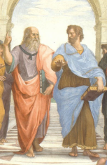
Notes, etc.…

